Slide 1
L4/5 Group 4
Ripple Footie
Connor Wilby
Sam Clack
Henry Smith
Heather Bishop

Slide 2
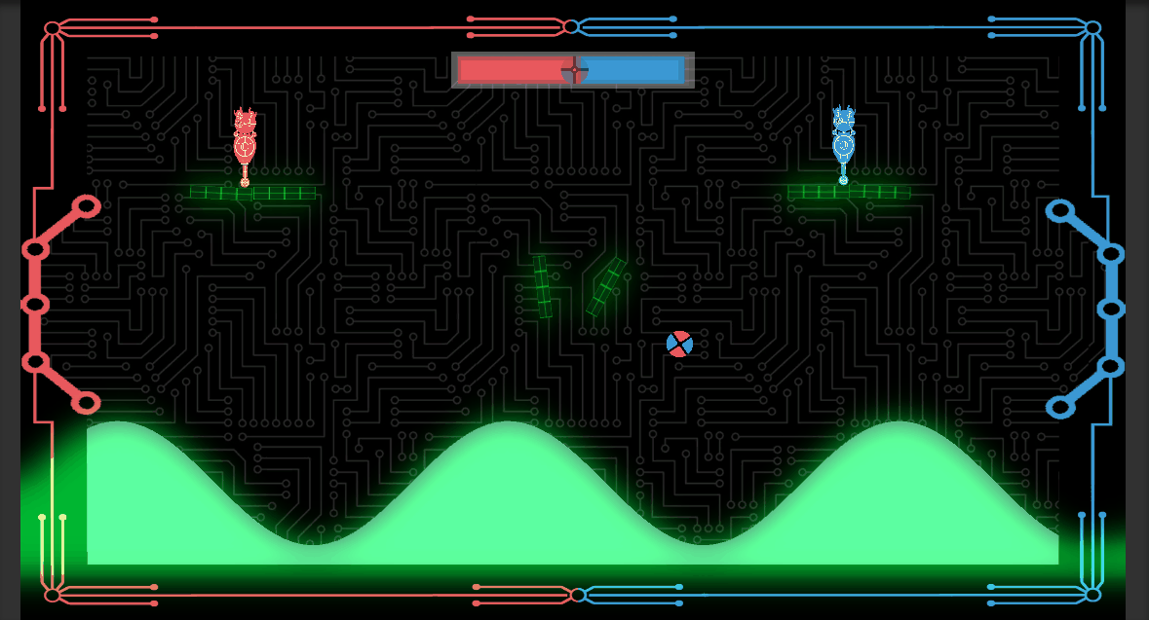
Where We Finished Last Time…
Adding polish to excising mechanics and experience.

Slide 3
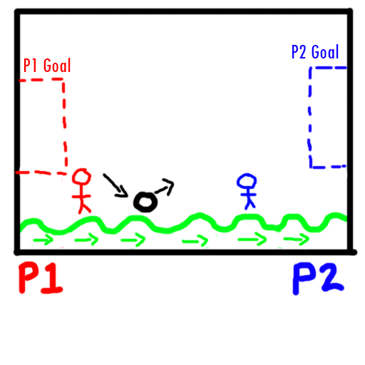
Expected Delivery Standard
Objective: Two players must get a single ball into the opponents goal.
Symmetrical simultaneous gameplay.
Fully operational UI/Visual Feedback.

Slide 4
Expected Delivery Standard
Fine tuned wave (e.g. when to start, how fast, who receives the starting advantage).
Completed art assets.

Slide 5
How Does It Meet The Brief?
Physics generated by the terrain mimicking a wave.
Gameplay is symmetric/simultaneous.
Our game is original because it takes a tried and tested formula for multiplayer and puts a different spin on it by making the terrain the true adversary.

Slide 6
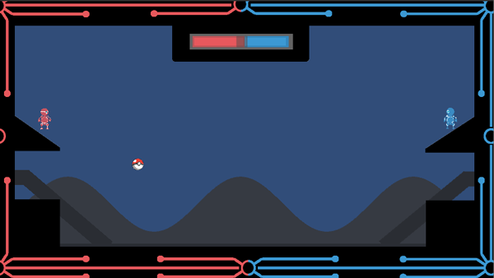
The Wave
Uses fancy mathematics to generate a wave from a single object.
Issues with collision detection with the players feet.

Slide 7
The Wave
Creates a much more diverse effect, and gives us more control of what it does and when.
Material limitations.

Slide 8
The Player Controller
Because of the collision issues, jumping is still being iterated.
Currently implimented:
Main Menu
Character movement
Wave
Scoring goals (and win condition)
End screens

Slide 9
Balancing Skill vs Chance
Skill is in the precision of judging the most opportune moment to hit the ball directly or when to bounce it off the wave.
The chance comes from how the wave alters the angle in which the ball bounces.
The use of three platforms with a hinge joint in the centre.

Slide 10
Playtesting
Playtesting results…
8 people play tested in total.

Slide 11
Playtesting
Observations
Players were not bored
Players were laughing, mocking each other and competing against each other in a friendly way.
There weren’t players winning/scoring more consistently than the other
No players gave up before the game was over.
If a player is more experienced at the game, then skill can overcome chance. This may need to be balanced in future.

Slide 12
Playtesting
Play tested both types of wave, and decided to use the maths wave as it created a better experience and allowed for a more customisable wave.

Slide 13
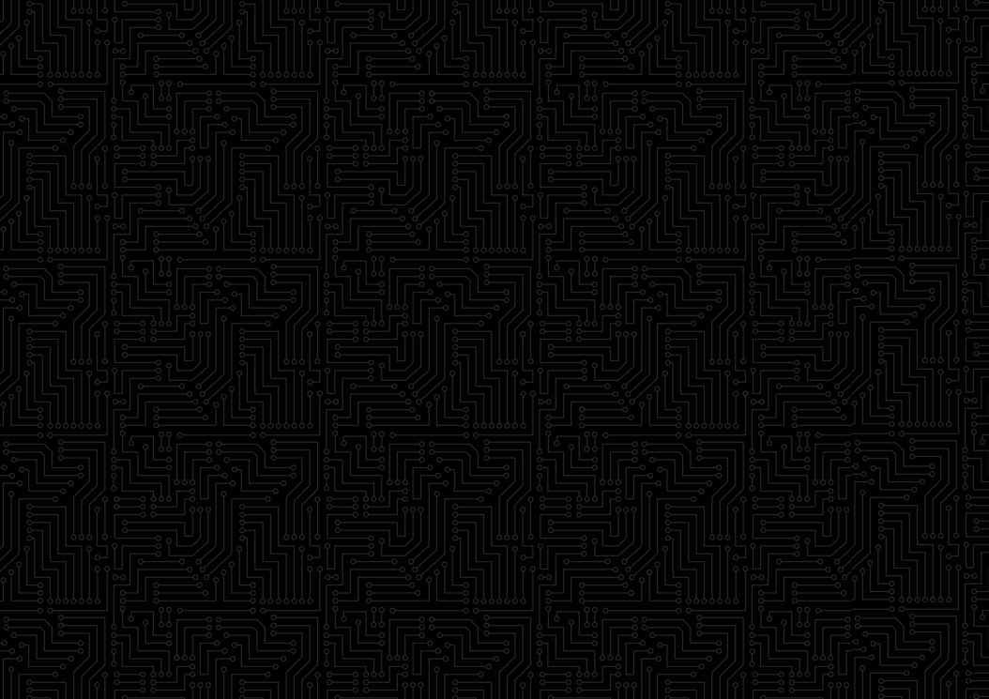

Aesthetics
Background is a solid colour with subtle detailing to adhere to squint test and prevent screen from being too busy.

Slide 14
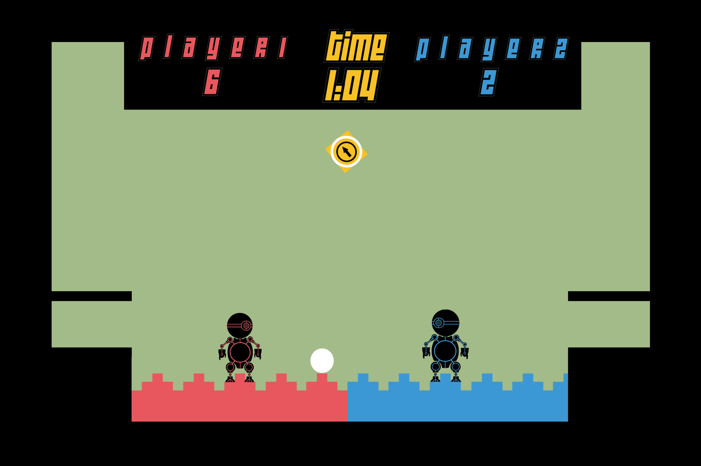
Aesthetics
Forground has been iterated many, many times.

Slide 15
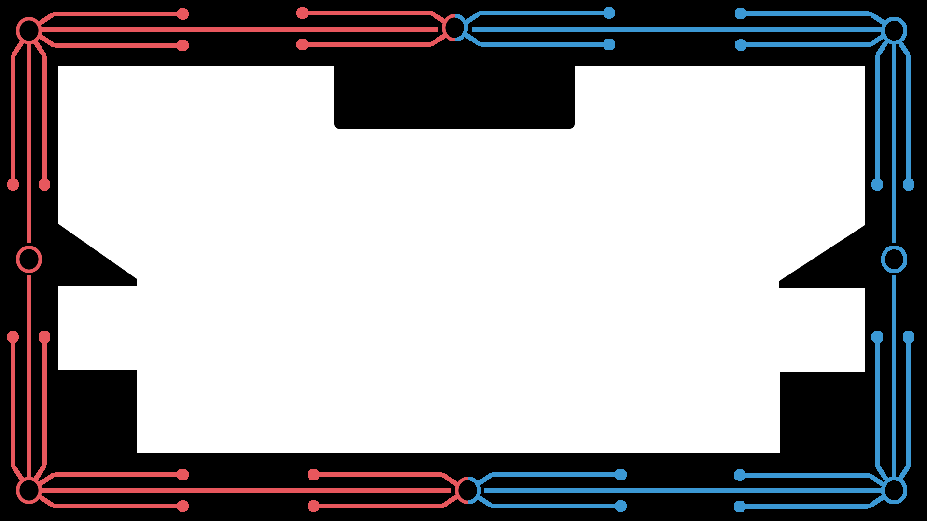
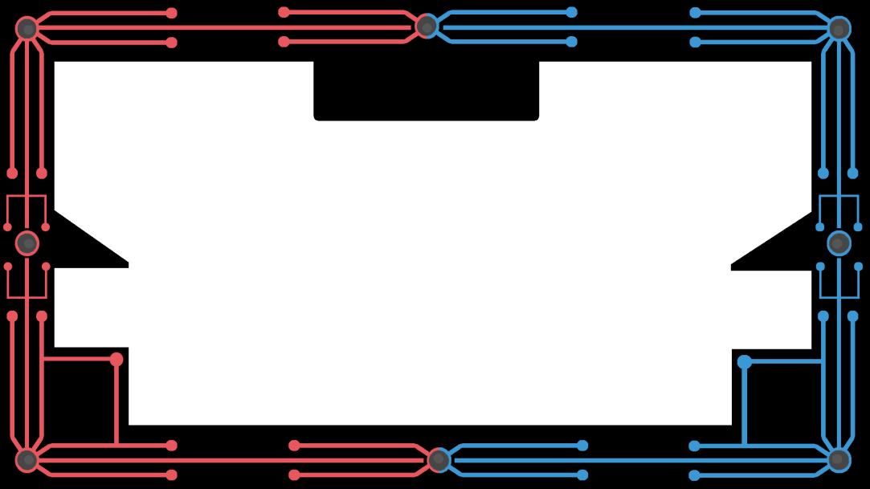
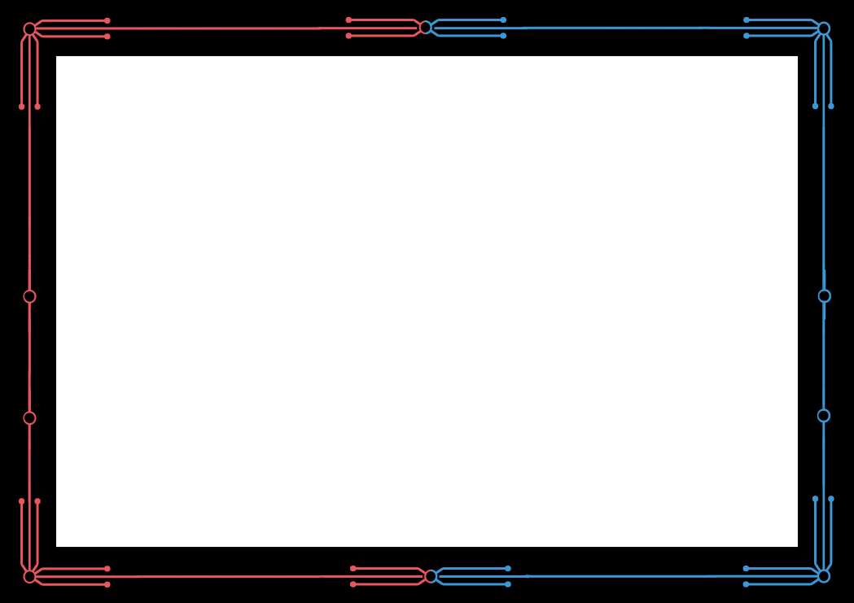
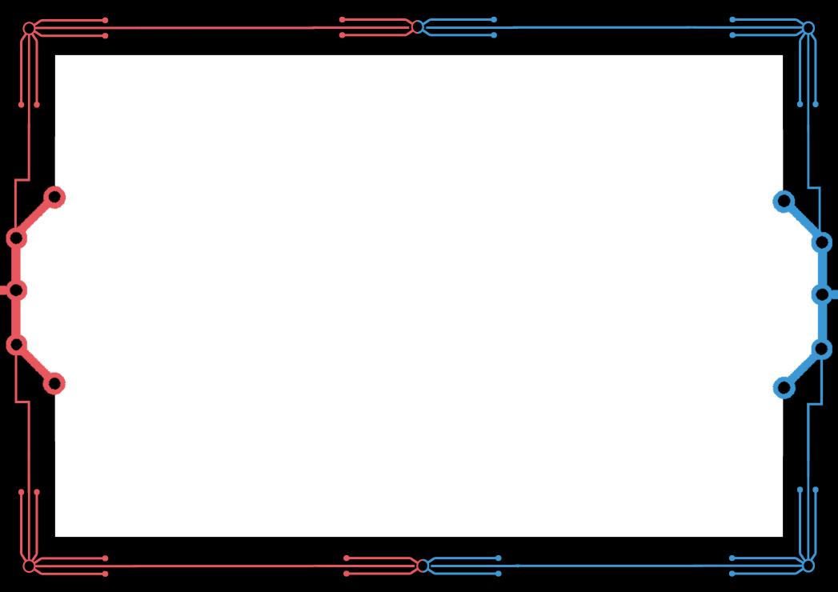
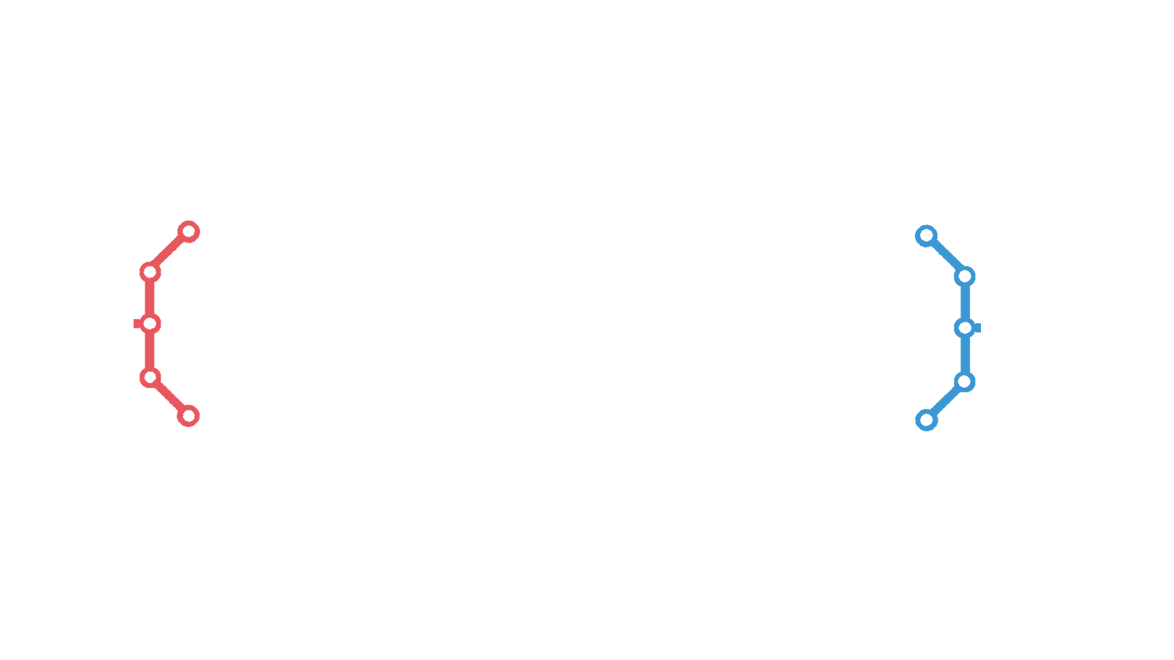
Foreground

Slide 16
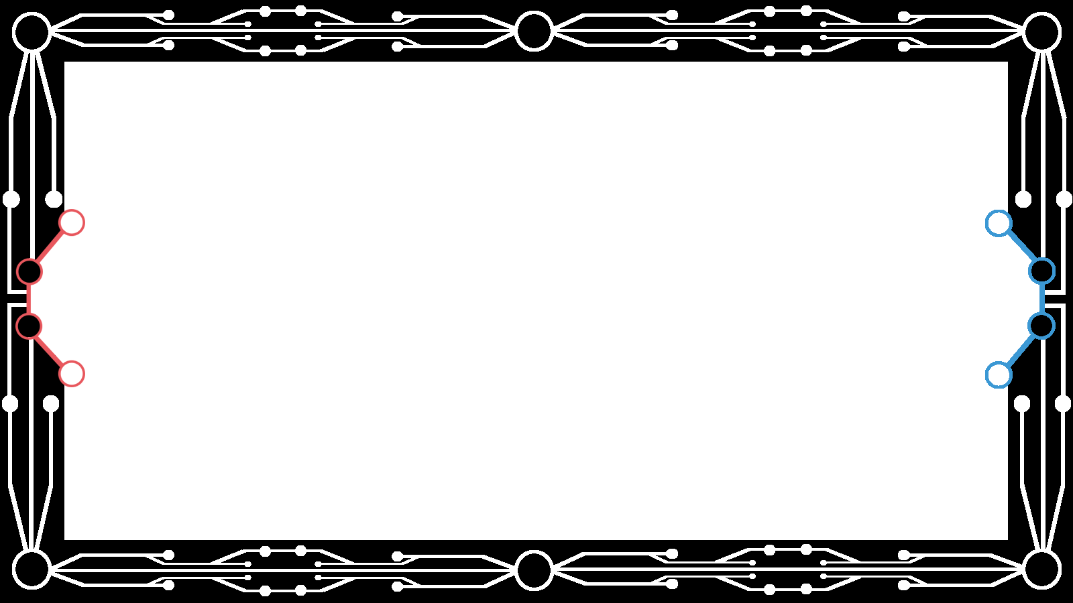
Current Iteration

Slide 17
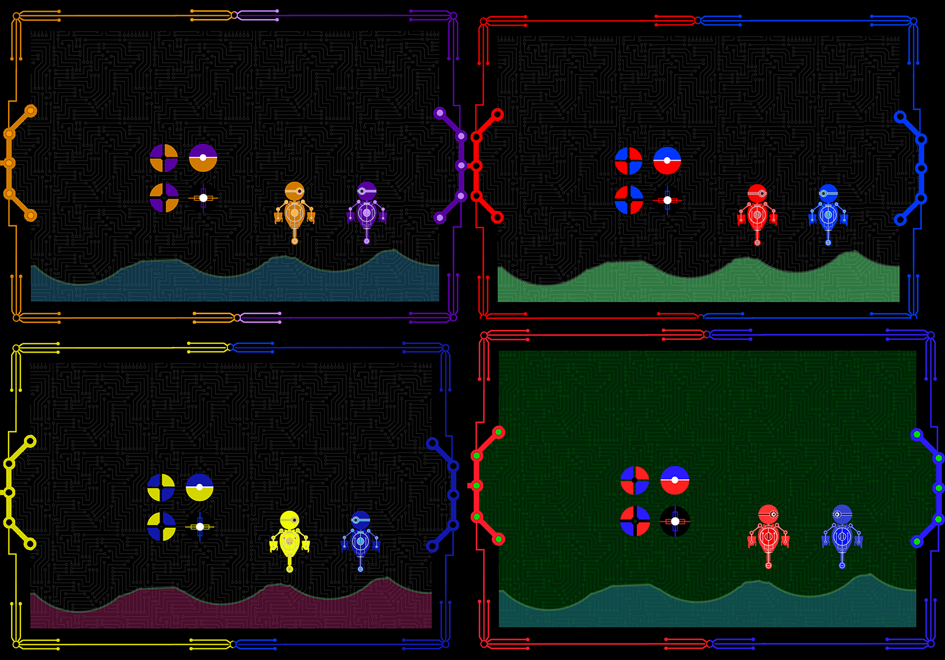
Colour Harmony's

Slide 18
Visual Feedback (Part 1)
Players found it difficult to determine when they had scored a goal.
No feeling of reward when a goal was scored.
Brainstormed ways to improve this part of the player experience.

Slide 19
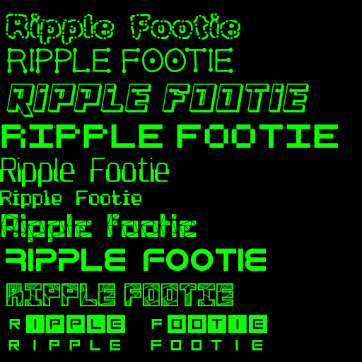
Visual Feedback (Part 2)

Slide 20
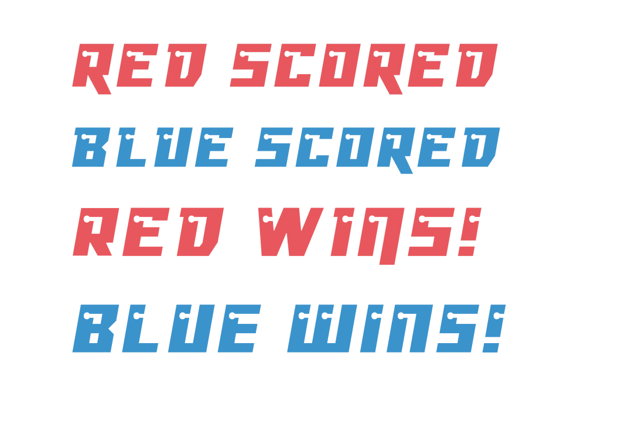
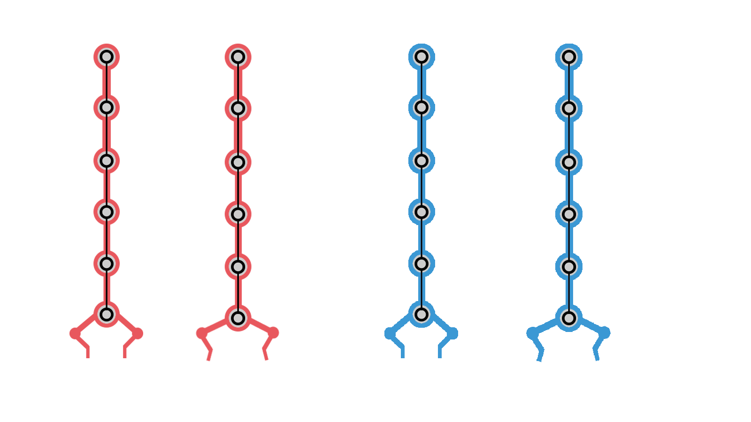
Visual Feedback (Part 3)
Popups.
Explosions.
Ball explodes.
Claw descending from the top to “drop” the ball.
The foreground is the UI.
Remove the UI bar.

Slide 21
Current Iteration

Slide 22
Sprint Information
Hours Logged
Connor:
Henry:
Sam:
Heather:
Emails Sent
Connor:
Henry:
Sam:
Heather:

Slide 23
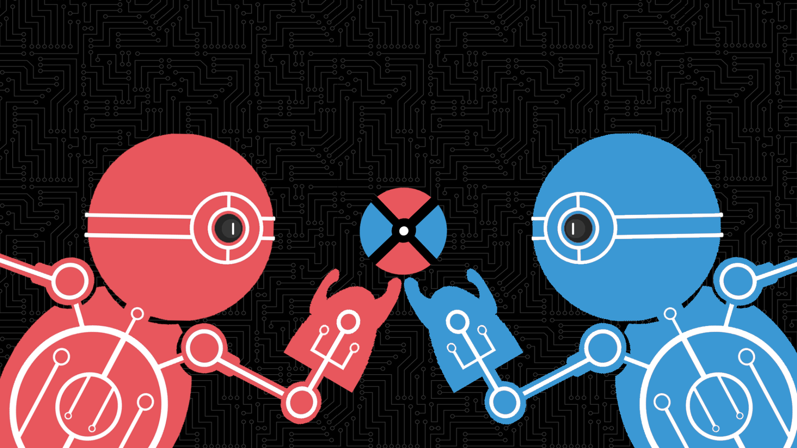
Questions?

